Slide 1
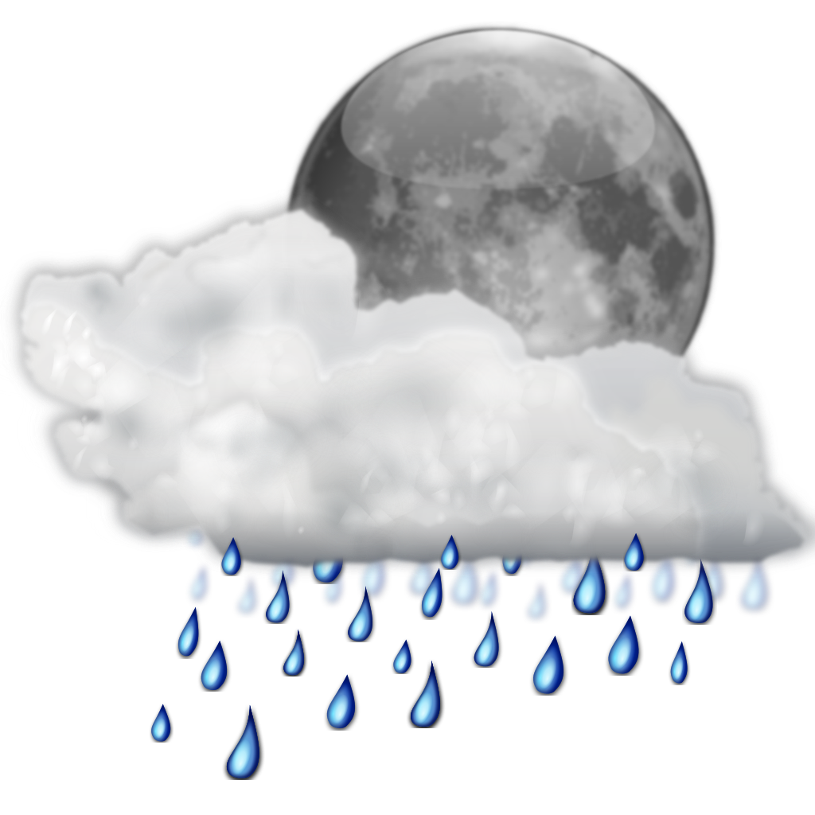
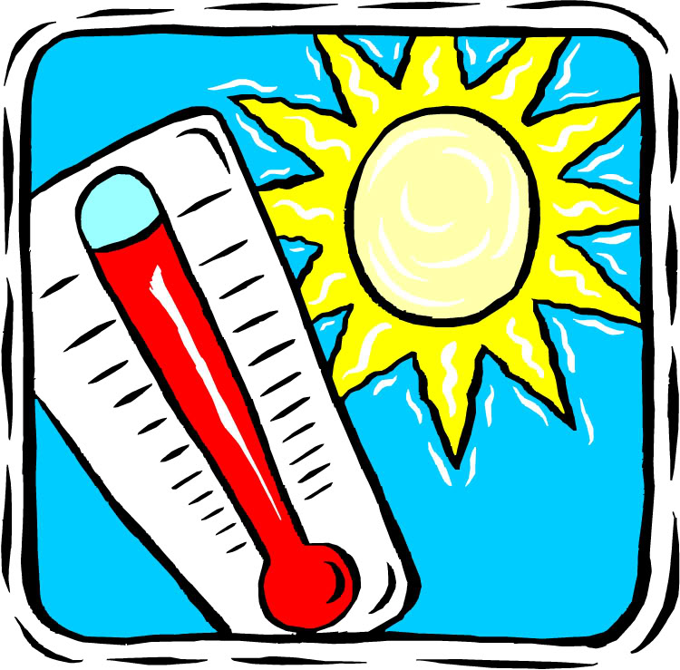
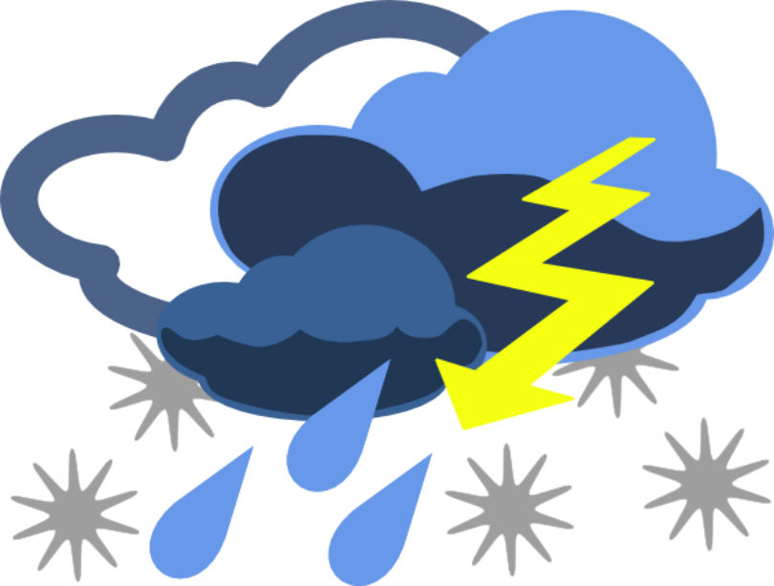
Elements of weather and climate

Slide 2
Air pressure

Slide 3
Air PRESSURE
Air has weight because of gravity and because of the weight exerts pressure.
Atmospheric pressure is measured by a barometer.
The units of measurement are referred to as hectopascals.

Slide 4
Air pressure
LOW PRESSURE SYSTEMS AND HIGH PRESSURE SYSTEMS

Slide 5
Low pressure systems
Low pressure systems are characterised by:
Lowest pressure in the centre of the system with pressures increasing towards the periphery or edge.
Relatively warmer or ascending air, spiralling in a clockwise direction (in the southern hemisphere)
Winds converging towards the centre.
Relatively unstable weather conditions caused by the uplift of air – often associated with rainy conditions.

Slide 6
high pressure systems
High pressure systems are characterised by:
Highest pressure in the centre of the system with pressures decreasing towards the edge.
Relatively cooler descending air (and becoming warmer) which spirals in an anti-clockwise direction (southern hemisphere).
Winds diverging away from the centre.
More stable weather conditions caused by descending air (which tends to be warm) and usually associated with fine weather conditions.

Slide 7

temperature

Slide 8
temperature
Refers to the degree of hotness of the atmosphere.
Temperature is measured by a thermometer.
The units of measurement are referred to as degrees Celsius (°C)

Slide 9
Factors – help to explain the variation of air temperature over time and place.
Day versus Night –
This variation is referred to as the diurnal range. The highest temperatures (maximum) normally occur at mid afternoon while the lowest temperatures (minimum) normally occur just before sunrise.
Latitude –
Increasing latitude, the thickness of the atmosphere increases as does the surface area over which the heat from a ray of sunshine must be spread, thus temperature decreases.
Seasonal variation –
Fluctuations in the position of the heat equator between the Tropics of Capricorn and Cancer result in variations in the distribution of heat.

Slide 10
Factors – help to explain the variation of air temperature over time and place.
Land and sea –
Land heats much faster than water and consequently becomes much hotter than the sea during the day. Conversely, the land loses heat much faster than water and so tends to be much colder than the sea at night time. The diurnal temperature variations for locations on the land are much greater than those close to the sea. The maritime effect refers to the lower seasonal and diurnal temperature ranges which are experienced by locations closer to the coast.
Wind direction –
Daily temperatures depend very much on the direction from which the winds blow. On a larger scale, winds which originate in tropical areas tend to be warm while winds originating from (or blowing across) polar air masses tend to be cold.
Ocean currents –
Warmer currents tend to affect the eastern side of continents and originate in warmer tropical waters. Cooler currents tend to influence the western side of continents.

Slide 11
Factors – help to explain the variation of air temperature over time and place.
Transparency of atmosphere/Cloud Cover –
Clouds can act as ‘sunshades during the day and as blankets at night’. This means that clouds will reduce insolation by blocking it out during the day time. However, once the land is heated, evening cloud cover tends to keep the heat in the atmosphere and to reduce the diurnal range. Desert areas tend to have little or no cloud cover and may often experience high daily temperatures and freezing nights.
Altitude –
The principal source of heat in the atmosphere is that which is radiated from the earth’s surface.
Air near the earth’s surface tends to be more dense and laden with dust and other particles compared with air in higher altitudes. The dense air tends to absorb heat better.
Air temperatures are higher close to the earth’s surface and decline with increasing altitude.

Slide 12
Factors – help to explain the variation of air temperature over time and place.
Aspect –
Slopes facing the sun receive more insolation during the day than those facing towards the poles.
Many houses in Australia are designed with windows facing n___________. This allows the sun to warm these areas during winter when the sun is lower in the northern sky.

Slide 13
Weather v Climate
Weather
* Weather is the short – term condition of the a_____________________ at a given place and time, such as: it is a rainy and cold day.
* Weather is measured by examining and looking at changes in daily temperature, precipitation (rainfall), wind speed and direction, cloud cover, humidity and atmospheric pressure.

Slide 14
Weather v Climate
Climate
* Climate is the long - term, average weather conditions for a location, calculated over a long period of time. This time period is generally 30 years.
* Climate is measured from long – term temperature and precipitation (rainfall) data. It is often expressed as seasonal averages and/or monthly averages.

Slide 15
Climate variability
Climate variability is the year-to-year variation in monthly or seasonal conditions.

Slide 16
Syllabus Point
* the spatial distribution of the world’s rainfall and temperature patterns

Slide 17
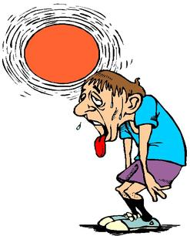
Spatial distribution of Temperature
* Temperature recordings can be presented as minimums, maximums or averages.
* Climate temperature data is most commonly processed to provide monthly averages.
* There is greater temperature variation (extremes) in the ____________________ hemisphere compared to the Southern.
* Ocean currents affect land air temperatures when winds blow from the sea.
* Landmasses show greater variations in air temperature over the year than ocean air temperatures.
* Coastal temperatures are generally more moderate than inland temperatures.
* Temperatures in both summer and winter generally decrease with __________________ distance from the ___________________.
* Seasonal and diurnal (difference between day and night) temperatures vary more where there is less water vapour – low humidity and clear skies.

Slide 18
Spatial distribution of Temperature
* Temperature recordings can be presented as minimums, maximums or averages.
* Climate temperature data is most commonly processed to provide monthly averages.
* There is greater temperature variation (extremes) in the Northern hemisphere compared to the Southern.
* Ocean currents affect land air temperatures when winds blow from the sea.
* Landmasses show greater variations in air temperature over the year than ocean air temperatures.
* Coastal temperatures are generally more moderate than inland temperatures.
* Temperatures in both summer and winter generally decrease with increasing distance from the Equator.
* Seasonal and diurnal (difference between day and night) temperatures vary more where there is less water vapour – low humidity and clear skies.

Slide 19
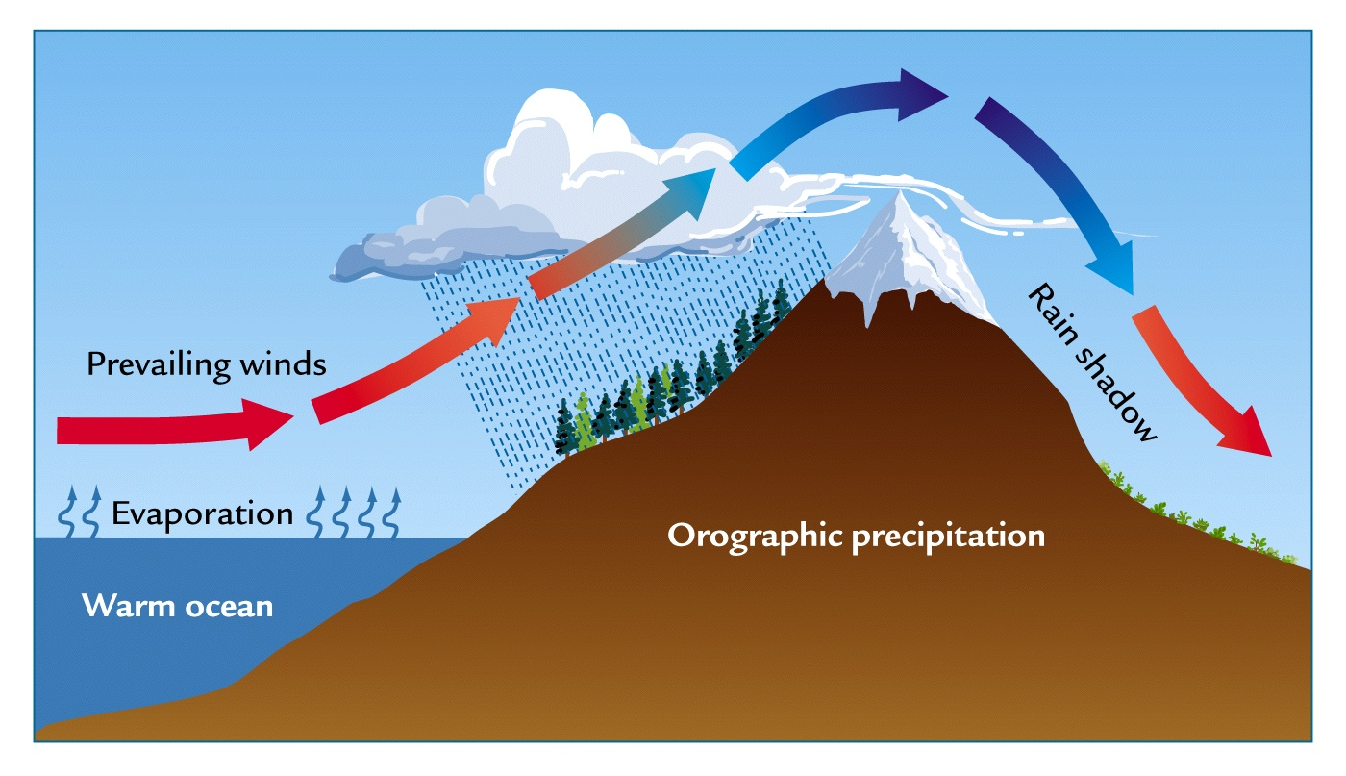
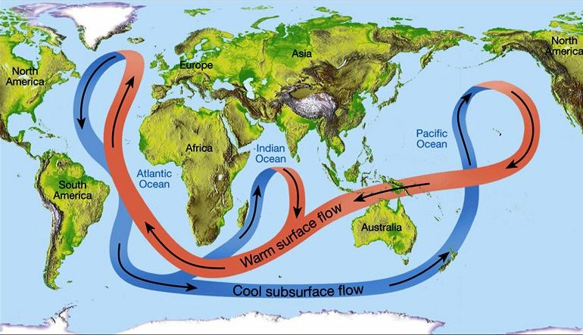
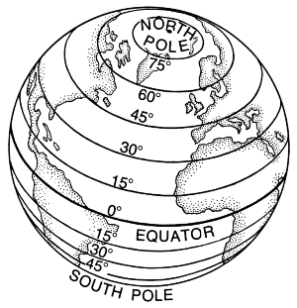
OLDMAP – Factors affecting CLIMATE
O –
L –
D –
M –
A –
P –

Slide 20
OLDMAP – Factors affecting CLIMATE
O – Ocean Currents
L – Latitude
D – Distance from Sea
M – Mountain Barriers
A – Altitude
P – Prevailing Winds

Slide 21

Spatial distribution of Precipitation
* Equatorial regions have the highest average precipitation rates.
* Continental interiors tend to be drier due to their distance from the oceans.
* Deserts occur on the west coasts and interiors of continents in the latitudes dominated by high pressure systems.
* Land areas adjacent to cool/cold ocean currents have less precipitation than areas where there are warm ocean currents.
* Cold air masses over polar regions contain little moisture and therefore less p________________.
* Mountain ranges both increase and decrease p__________________.

Slide 22
Mountain ranges and precipitation
* Windward slopes facing the moisture bearing winds produce orographic uplift and increased precipitation.
* ‘Leeward slopes’ form what are known as rain shadows.
* Orographic rainfall occurs when winds push moist air over elevated landforms such as mountains.
E.g. In Australia more rain falls on the eastern side of the Great Dividing Range than on the western side.

Slide 23
Climate change
Climate change refers to any significant statistical difference in the measurements of some or all elements of the weather conditions (e.g. atmospheric composition, temperature, precipitation) in a particular place over the long term (e.g. decades or thousands of years). For example, it occurs when the long-term weather pattern demonstrates a general warming or cooling of the atmosphere, compared to the average. Over recent human history, global temperatures have increased by 0.85°C since 1880.

Slide 24
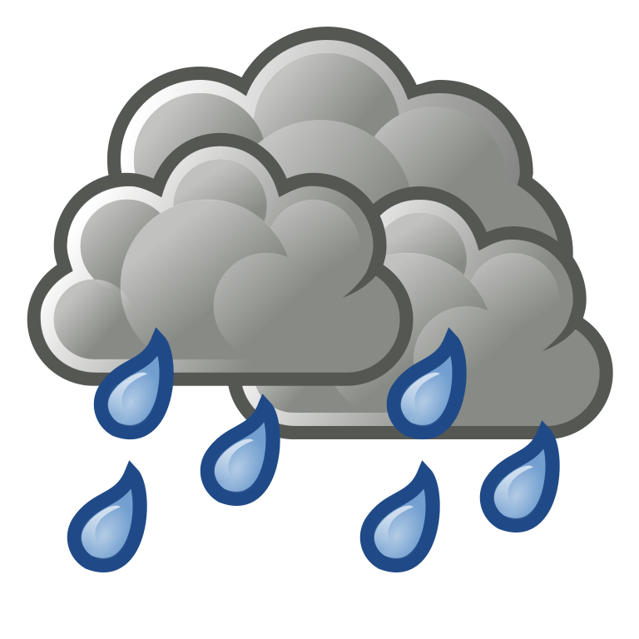
Rainfall 3 MAIN TYPES

Slide 25
CONVECTIONAL RAINFALL
This type of rainfall occurs in warmer regions.
Incoming insolation rapidly heats the surface of the earth which in turn heats the atmosphere, causing it to expand and become less dense. The air then rises in convection currents. As it rises it cools. When saturation point is reached, condensation occurs.
In equatorial regions (near the Equator), convectional rainfall is very predictable, usually occurring every afternoon when the land has heated sufficiently to create convectional currents.
Convectional rainfall also occurs in some parts of Australia, particularly from December to March in the northern parts when hot humid conditions exist.

Slide 26
OROGRAPHIC RAINFALL
Occurs where mountains force moisture laden winds to rise, the temperature of the air falls, condensation occurs and heavy precipitation results.
The side of the mountain barrier where rain falls is called the w__________________ side. The other side of the mountain is called the l_____________ side and receives vastly reduced rainfall. This side is referred to as the r_______________.

Slide 27
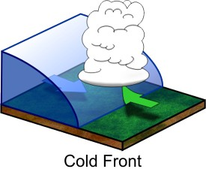
FRONTAL RAINFALL
Frontal rainfall occurs when an advancing mass of cold air (a c________ f___________) forces relatively warmer air to rise over the cold air mass.
Cooling with increasing altitude and contact with colder air occurs and eventually p________________ results.
Most common in southern Australia, including the South West of W.A., especially during winter.

Slide 28
Natural Systems that drive the Earth’s Climate
Natural systems include:
- The Heat Budget
- Natural Greenhouse Effect
- Hydrological cycle
- Atmospheric circulation
- Carbon Cycle

Slide 29
Syllabus Point
* the key elements of the following natural systems: heat budget (including the greenhouse effect), hydrological cycle, carbon cycle and atmospheric circulation, and the ways in which they interact to influence the Earth’s climate.

Slide 30
Sample Questions
1. Describe four key elements of one of the following:
- hydrological cycle
- ecosystem structure
- atmospheric circulation
- ecosystem dynamics
- heat budget
- carbon cycle
(8 marks)

Slide 31
Sample Questions
2) With the aid of a diagram, briefly describe the key elements of one (1) of the following:
Heat budget
Hydrological cycle
Carbon cycle
Atmospheric circulation
Ecosystem structure
Ecosystem dynamics
(4 marks)

Slide 32
Key Terms - Definitions
Define the following terms. Provide examples to support your definitions.
* Heat Budget
* Albedo
* Conduction and convection
* Absorption and reflection
* Natural greenhouse effect
* Greenhouse gases

Slide 33
The Heat Budget
✰ As the short wave i_________________ passes through the atmosphere some is reflected back into space by clouds and particularly matter. Some of it is reflected from light coloured surfaces on the earth (albedo), such as ice and snow. Albedo – degree of reflection of a surface.
Albedo – The capacity of different surfaces to reflect sunlight. It is a measure of the reflectivity of the earth’s surface. Ice, especially with snow on the top has a high albedo.
✰ Approximately 19-20% of the insolation is a___________________ by clouds and particles such as ozone molecules. This leaves approximately 50-51% of the short-wave energy actually being absorbed by the earth’s surface where the solid earth changes this radiant energy to heat energy and thus becomes warm. This then leads to the warming within the lower atmosphere, through the various processes including – radiation, evaporation, convection, conduction…
✰ Heat budget – generally is seen as a balance between incoming and outgoing energy. This helps to maintain the earth’s temperature at a relatively constant level. Imbalances in the h__________ b_____________ can lead to significant changes in the earth’s climate. This could be through natural processes, such as circulation of ocean currents or by human activity leading to changes in the composition of gases within the atmosphere.

Slide 34
The Hydrological Cycle
- Water is in a constant circulation system known as the hydrological cycle.
- This cycle carries water from the oceans, through the atmosphere to the land and back to the sea.
- Main source of energy in the hydrological cycle is the _ _ _.
- There is no starting or finishing point to the hydrological cycle.
- Each process is continuous and involves water either moving physically or changing state from l___________, g______ or s_____________.

Slide 35
The Hydrological Cycle
PERTIC:
* Precipitation – occurs when the suspended droplets in the a______________ fall as rain, hail, sleet or snow. Approximately 79% of precipitation falls on the oceans and 21% falls on land.
* Evaporation – occurs when water is heated and changes into w_________ v__________. The oceans supply approximately 85% of the evaporated water and the land supplies approximately 14% through e__________________.
* Runoff - occurs when some precipitation remains on the surface and feeds into rivers, streams, lakes and wetlands.

Slide 36
The Hydrological Cycle
* Transpiration - is the process whereby plants lose moisture to the a______________. Plants take in moisture from the soil and release it through pores on leaves. Animals also lose water through their respiration.
* Infiltration - occurs when surface water seeps underground to become g_______________. It then flows into rivers, streams, lakes and seas or artesian basins.
* Condensation - occurs when w__________ v__________ cools as it rises in the atmosphere and forms clouds, mist and fog.

Slide 37
Atmospheric Circulation
Atmospheric Circulation refers to the general movement of the air across and above the surface of the Earth.
It is a natural system which developed in responses to the uneven heating of the Earth.
The pressure systems and winds that are created help to redistribute heat away from the Equator towards the Poles.

Slide 38
Atmospheric Circulation
Global air pressure belts and prevailing wind systems are the product of the heat budget, the rotation of the earth and localised effect of landforms.
These wind and pressure systems shift north and south by about 15 degrees of latitude over the course of a year. Causes – tilt of the earth’s axis and effect that this has on overhead position of the sun.

Slide 39
Atmospheric Circulation System
Pressure Belts:
The earth is heated unevenly by the sun.
Warm air rises forming low pressure systems at the surface.
Cold air descends creating high pressure systems.
Belts of pressure form across the earth as a result.
Examples: Polar Highs (found between 60 and 90 degrees north and south), Sub Polar Lows (found between 30 and 60 degrees in either hemisphere) , Sub Tropical Highs (found between 15 and 30 degrees in northern and southern hemisphere), Equatorial Lows (shifts north and south in a zone 15 degrees either side of the Equator)

Slide 40
Key Elements – Atmospheric Circulation
Air Movement in Low Pressure Systems
* Air in low pressure systems moves away from the earth’s surface. As it does so it becomes cooler and less stable. Condensation occurs as dew point is reached with p___________________ likely to follow. Air also circulates into low pressure cells. It is clockwise in the southern hemisphere and anti-clockwise in the northern hemisphere.

Slide 41
Key Elements – Atmospheric Circulation
Air Movement in High Pressure Systems
* Air in high pressure systems sinks towards the earth’s surface and is heated by compression. This increases its ability to absorb water vapour and decreases the probability of precipitation. Fine, dry conditions are common in high pressure zones. It is clockwise in the northern hemisphere and anti-clockwise in the southern hemisphere.

Slide 42
Key Elements – Atmospheric Circulation
High and Low Pressure Belts
* Pressure belts form alternating bands of high and low pressure with winds blowing from high pressure to low pressure cells.
* High pressure systems mainly correspond to regions of low precipitation.
* Low pressure belts correspond to the rainy regions of the globe.
* The heat budget is mainly responsible for the global pressure belts surrounding the earth.

Slide 43
Atmospheric Circulation System
Wind Systems:
Air moves from areas of high pressure to areas of low pressure, creating winds across the surface of the Earth.
Examples: Easterlies, Westerlies, Trade Winds

Slide 44
Atmospheric Circulation System
Circulation Cells:
Warm, rising air and cold, falling air create circulation cells within the troposphere between the pressure belts.
Example: Hadley cells

Slide 45
The Carbon Cycle
* Carbon is found in all living things as well as atmosphere, rocks, soil and water.
* Carbon deposits are called sinks. They are also sources of carbon.
* Carbon is exchanged between different sources and sinks.
* Carbon dioxide is found in the atmosphere as a greenhouse gas. Has an important effect on weather and climate.

Slide 46
Key Elements – The Carbon Cycle
The Atmosphere
Atmospheric carbon (carbon dioxide) has increased over the last 200 years.
Atmospheric carbon plays an important role in the heat budget as a greenhouse gas.

Slide 47
The Carbon Cycle
Vegetation
Vegetation and phytoplankton are important in the removal of CO2 from the atmosphere.
Carbon uptake by vegetation offsets carbon which is released into the atmosphere from the soils.

Slide 48
The Carbon Cycle
Soils and fossil carbon
Soils, rocks and fossil fuel deposits are major stores of carbon, some of which can be released into the atmosphere.
Most of the world’s carbon is found in rocks such as limestone.
Some soils, such as permafrost soils, lock carbon away while they remain frozen and release it when they thaw.

Slide 49
The Carbon Cycle
The Oceans
The oceans are major carbon sink, especially when it is taken down into the deep ocean.
Over time (long) carbon will form sedimentary deposits on the ocean floor.
Changes in ocean temperature can affect the rate at which carbon is absorbed or released.
Warm oceans release more carbon than they absorb.

Slide 50
The Carbon Cycle
Anthropogenic Carbon
Increasing amounts of carbon are being released into the atmosphere from i____________, u________ and rural activities.
This is greater than the capacity of vegetation or the oceans to remove it.
This imbalance is mainly responsible for the rise in atmospheric carbon levels and for changes in the greenhouse effect, known as the e______________ greenhouse effect.

Slide 51
Causes of Climate variability
Changes in the heat budget, hydrological cycle, atmospheric circulation and ocean currents will produce climate variability.

Slide 52
Syllabus Point
* the interrelationship between land cover change and climate.

Slide 53
Examples:
* Clearing of land for agriculture or urban development reduces carbon sequestration (e.g. reduction in the storage capacity of the Earth’s carbon sinks)
* Land cover change can cause changes to surface albedo/reflectivity. (e.g. can have a positive and negative impact on heat absorption)

Slide 54
Causes of Climate Change
* Natural causes
(Natural climate change)
* Anthropogenic causes
(Anthropogenic climate change)

Slide 55
Natural Causes – Global Climate Change
Examples:
* Orbit variations – Changes in the earth’s orbit and/or axis.
* Axis variations
* Variations in solar output
* Changes in the angle of Earth’s inclination
* Changes in atmospheric composition
* Volcanic eruptions

Slide 56
Anthropogenic Causes – Global Climate Change
Examples:
* Burning of fossil fuels
* Land cover changes
* Intervention in natural systems
* Production of aerosols
* Increasing concentrations of atmospheric CO2 through the burning of fossil fuels
* The release of vast quantities of methane from herds of ruminant animals

